Slide 1
Molecular Epidemiology
Introduced by Kilbourne (1973), infectious diseases; Schulte and Perera (1993 Principles and Practices)
Integrates Epidemiology, Medical Sciences and Molecular Biology
Studies the influence on health of environmental and genetic risk factors measured by (holistic) molecular signatures
Contributes to
prediction/prognosis
monitoring exposure, response to interventions
etiological understanding (disease mechanisms)
Notes:
The Molecular Epidemiology field started first with the study of cancer and infectious diseases , the concept being initiated in 1973 and descibed in practice only in 1993. Summarise what the field is about.

Slide 2
Exposure Events in lifetime perspective
Measurable
Marker
Level
Exposure
Early or later
life condition
Genes
Environment
Stochasticity
Physiological
consequence
Diagnosis
Clinical + Disease
Endpoint Progression
Life Time
Notes:
To link this knowledge to physiological events that occur in a lifetime and increase susceptibility to disease, we use the term biomarkers.
Following exposure one wishes to detect the physiological consequences that preceed disease, that help in stating a range of outcomes : the diagnosis , a clinical endpoint, disease progression.

Slide 3
Biomarkers I
Relation of Exposure /determinant and outcome
Exposure: environment (early, late, diet, lifestyle, chemicals, geography), host (genetic background, age), health change over time (disease, biological ageing process); outcome = phenotype
Biomarker (WHO): a substance or biological structure that can be measured in the human body and may influence, explain or predict the incidence or prognosis of outcome of disease

Slide 4
Biomarkers II
a characteristic that is objectively measured and evaluated as an indicator of normal biological processes, pathogenic processes, or pharmacologic responses to a therapeutic intervention
or NIH biomarker working group:
a characteristic that is objectively measured and evaluated as an indicator of normal biological processes, pathogenic processes, or pharmacologic responses to a therapeutic intervention

Slide 5
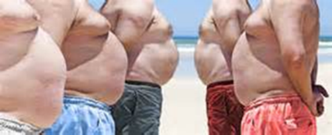

Classical Algorithms
Definition Metabolic syndrome
Abdominal obesitas >94 cm men, >80 cm women and ≥ two of the next:
• Fasting glucose >100 mg/dL (5,6 mmol/L) or diabetes
Triglycerides >150 mg/dL (1,7 mmol/L) or treatment
HDL-cholesterol <40 mg/dL for men, < 50 mg/dl for women or treatment
Blood Pressure > 130/85 mmHg SBP or treatment
Definition Framingham risk score (10 years CVD risk)
Age
• Gender
Smoking
Diabetes
Total cholesterol
HDL-cholesterol
Systolic Blood Pressure

Slide 6
Adding omics data to biomarker research
a characteristic that is objectively measured and evaluated as an indicator of normal biological processes, pathogenic processes, or pharmacologic responses to a therapeutic intervention
You have discussed epigenome/transcriptome
Now we will focus on the metabolome.
100.000 metabolites in your body
In blood: 4000 metabolites.
Best platforms measure about 600 in a standardized fashion high throughput

Slide 7
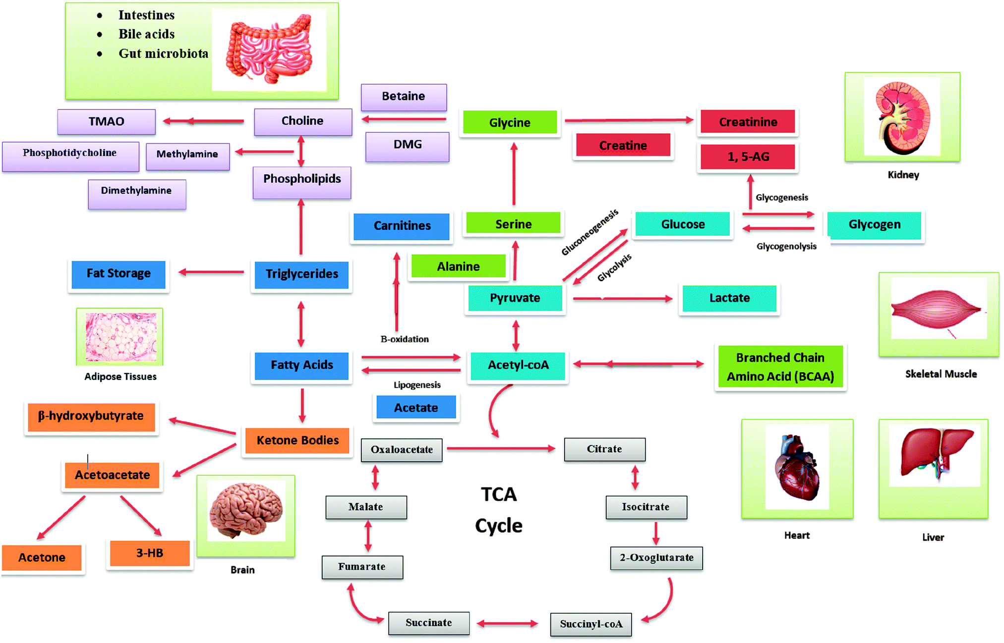
Which tissue functions do the 1H NMR metabolites represent ?

Slide 8
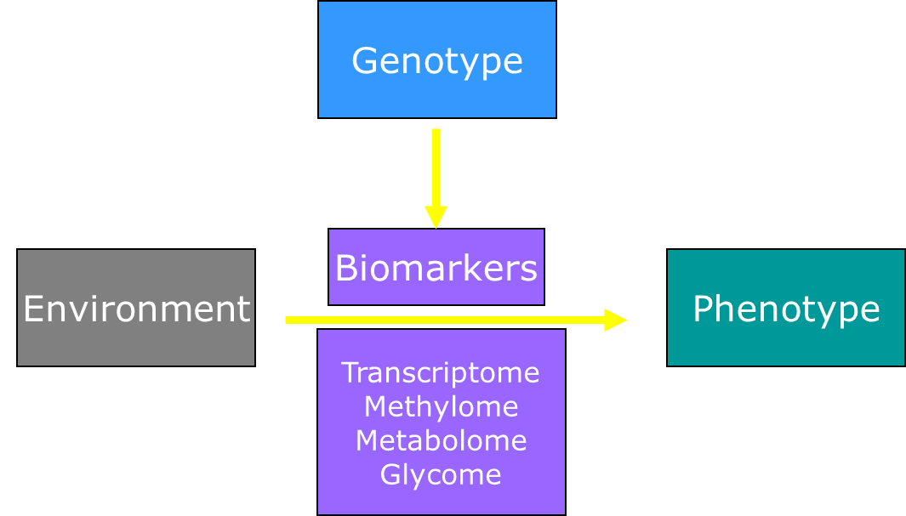
What relations do scientists investigate with molecular profiling data

Slide 9
What relations do scientists investigate with molecular profiling data

Slide 10
What relations do scientists investigate with molecular profiling data

Slide 11
Integrated studies in humans
Focused on ageing phenotypes
- Functional capacity (CGA)
- Resilience
Disease
Mortality, Longevity
- Biological Age; Surrogate + Endpoints of ageing

Slide 12
Molecular Biomarkers
Type II Diabetes prediction 1H NMR metabolites
Suhre et al. PLoS ONE |
November 2010 | Volume 5 | Issue 11
Notes:
Next time we will talk about quantitative variables ithat are being used as biomarkers

Slide 13
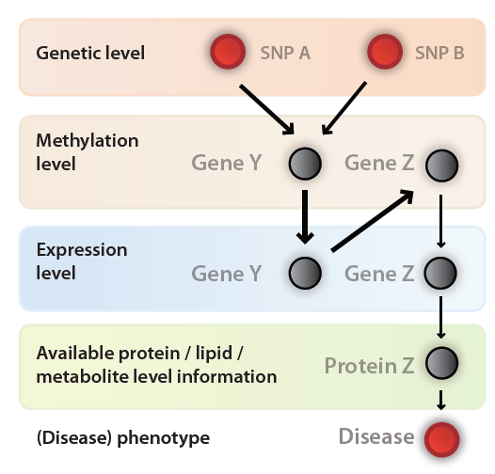

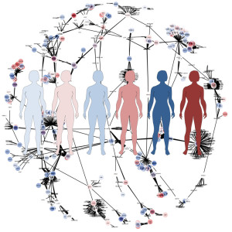
Datasets: BBMRI Biobanking consortium Multi-level omics data
N=100,000 GWAS
N=750 Go.NlL
N=4,000
BIOS
consortium
N=4,000
BIOS
consortium
METABOLITE
consortium
N=50,000
N>250,000
Central databases for the research community
Notes:
You know that in NL we are actually generating this information at all of these omics levels in the Dutch population, this will all be available so as a biomedical professional it is strategicallly very smart to develop analyses skills. For some research questions you do not have to collect data, you can enter them via the web or in a collaboration. Being able to analyse data is vital in the era of ‘big data’ and data sharing .

Slide 14

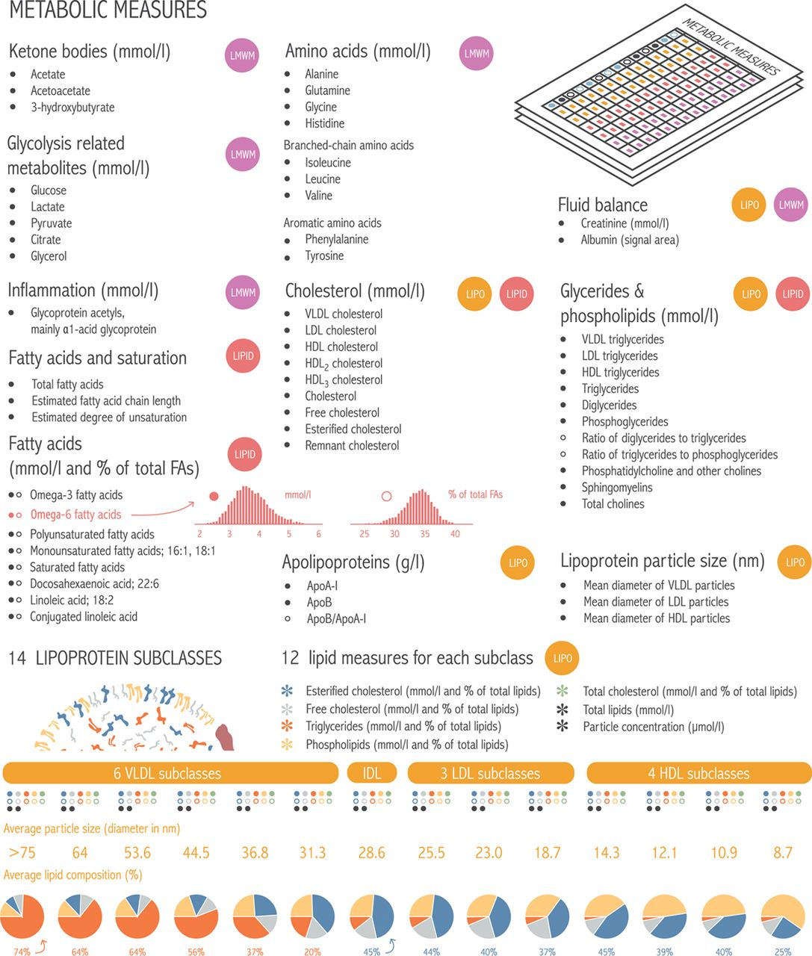
Nightingale Health platform
1H-NMR metabolomics platform
NMR-based quantification:
Standardized
High-throughput
Quantitative (mmol/l or g/l)
226 metabolic biomarkers
Lipids/FA/(apo)lipoproteins/aminoacid/glycolysis products
Widely-used in epidemiological studies.
Diabetes (type 1 & 2)
Cardiovascular disease
Neurological diseases

Slide 15
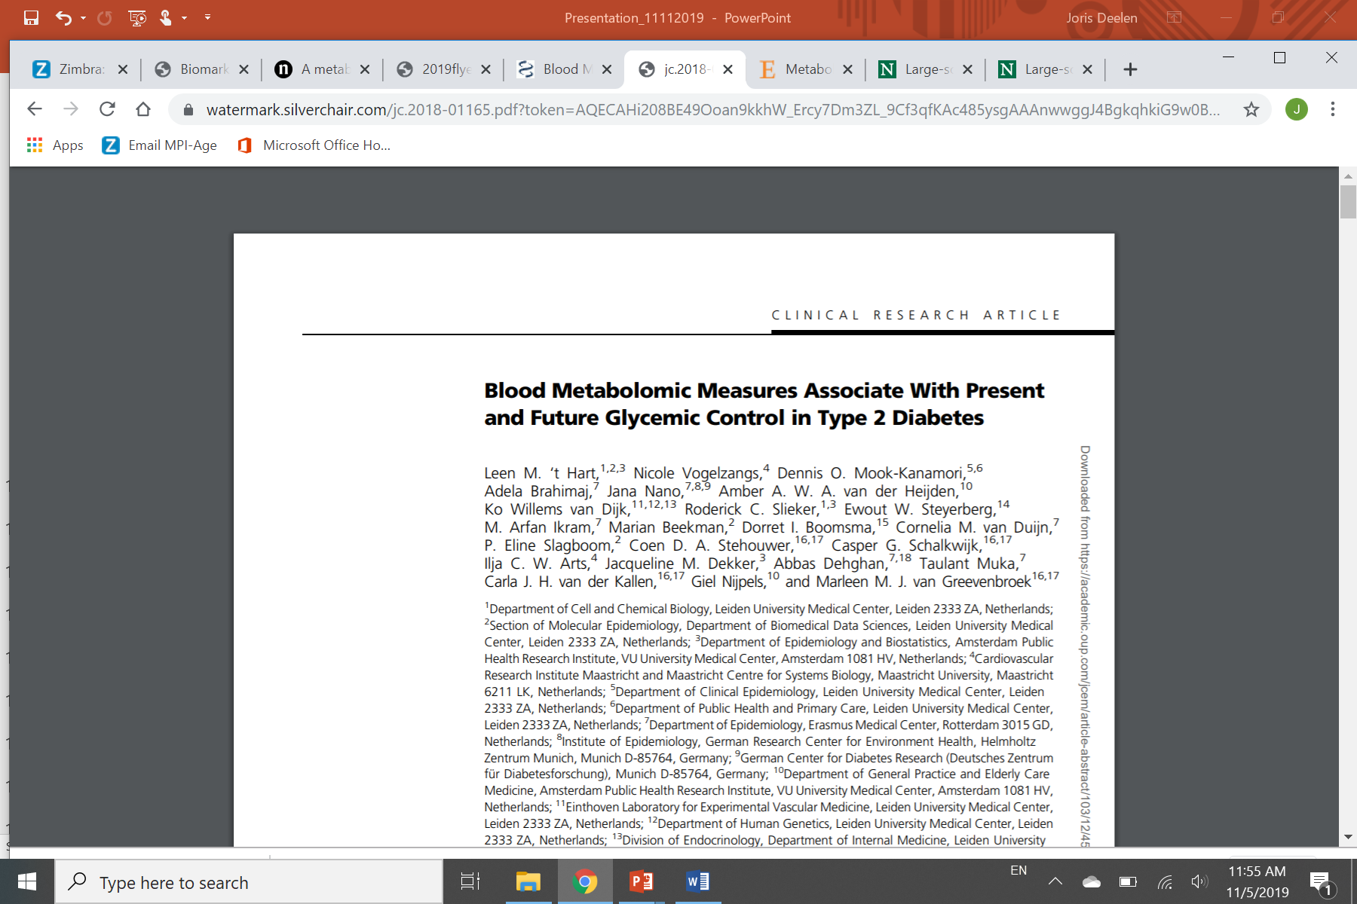
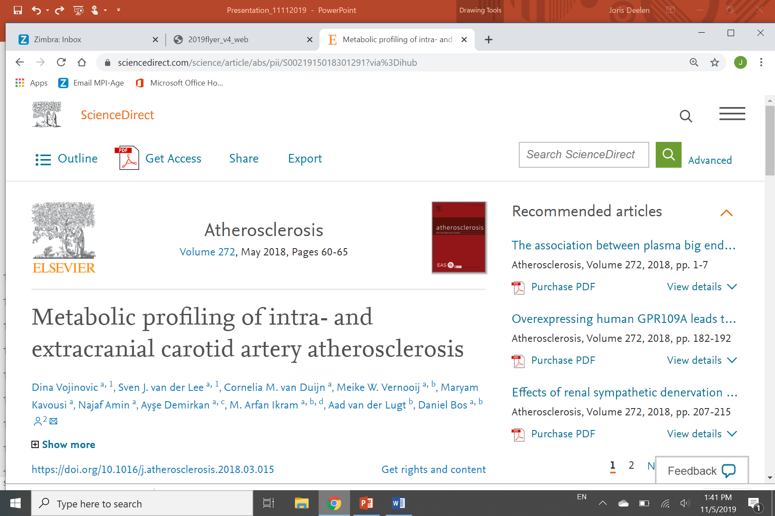
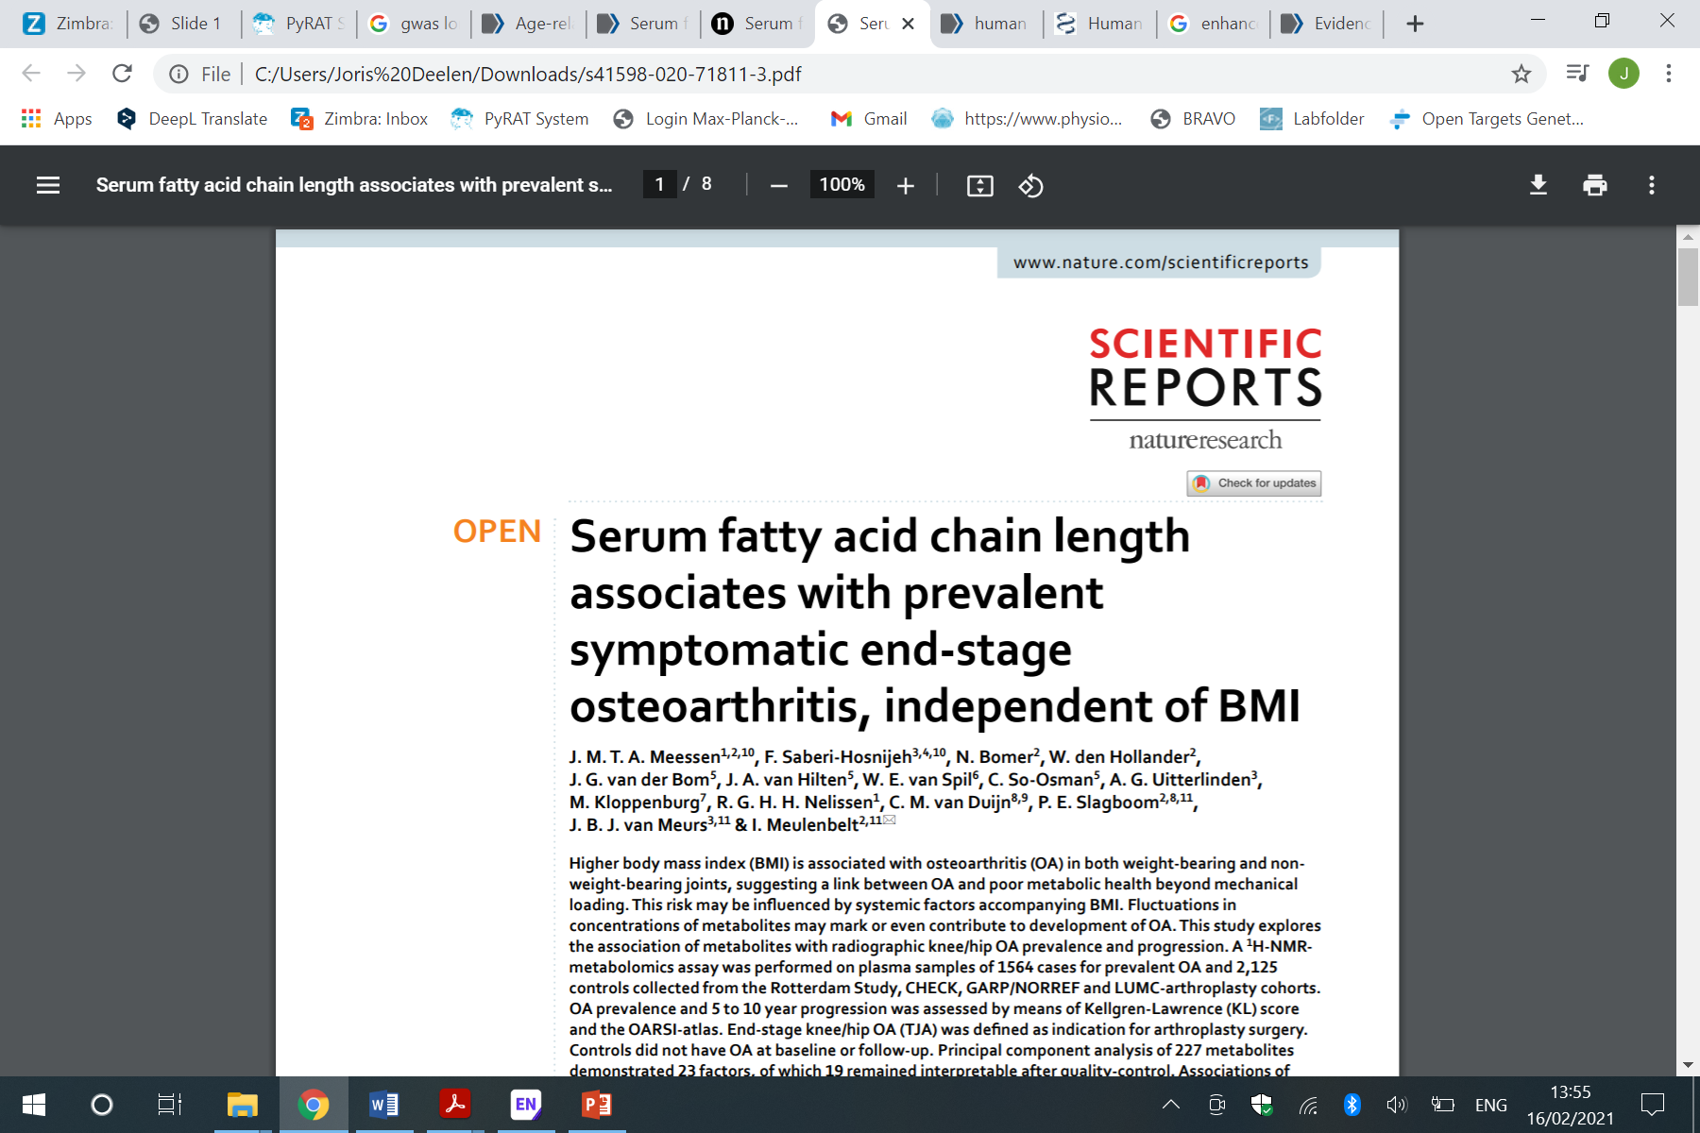
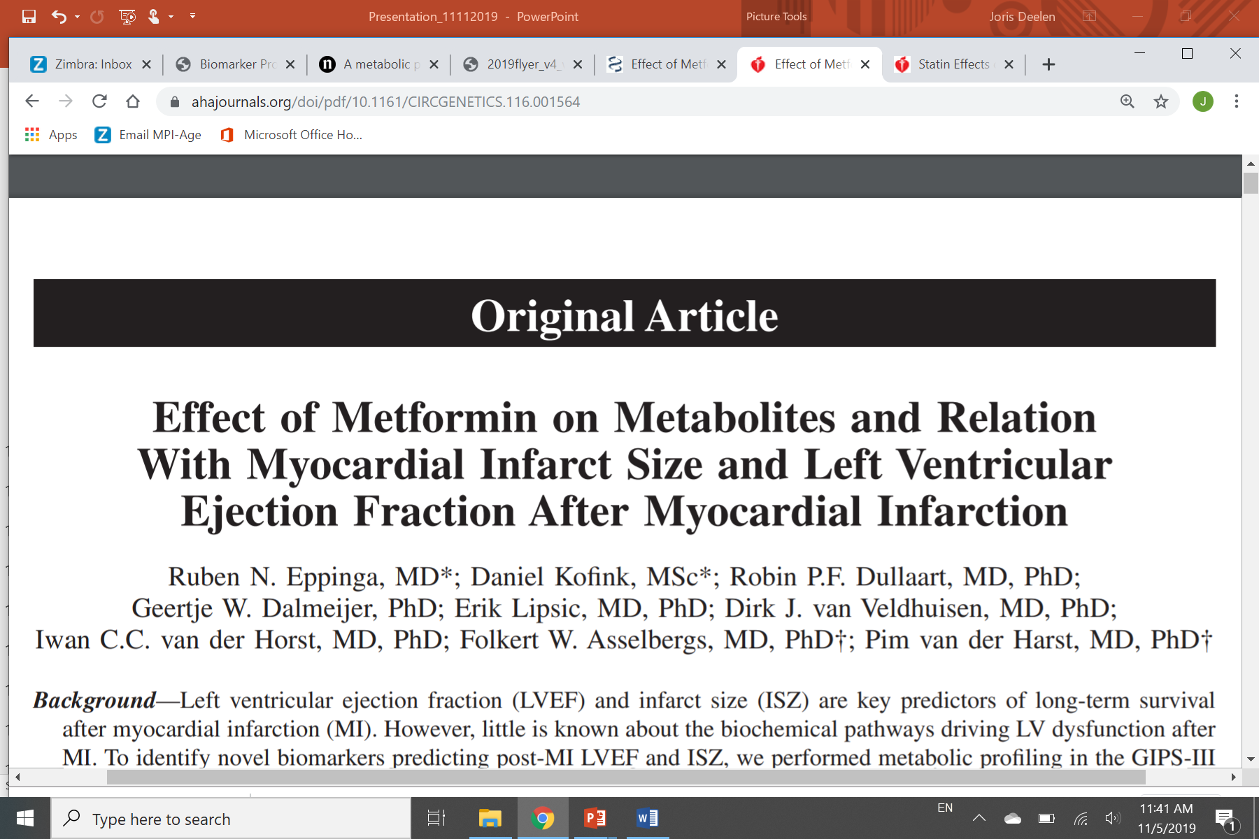
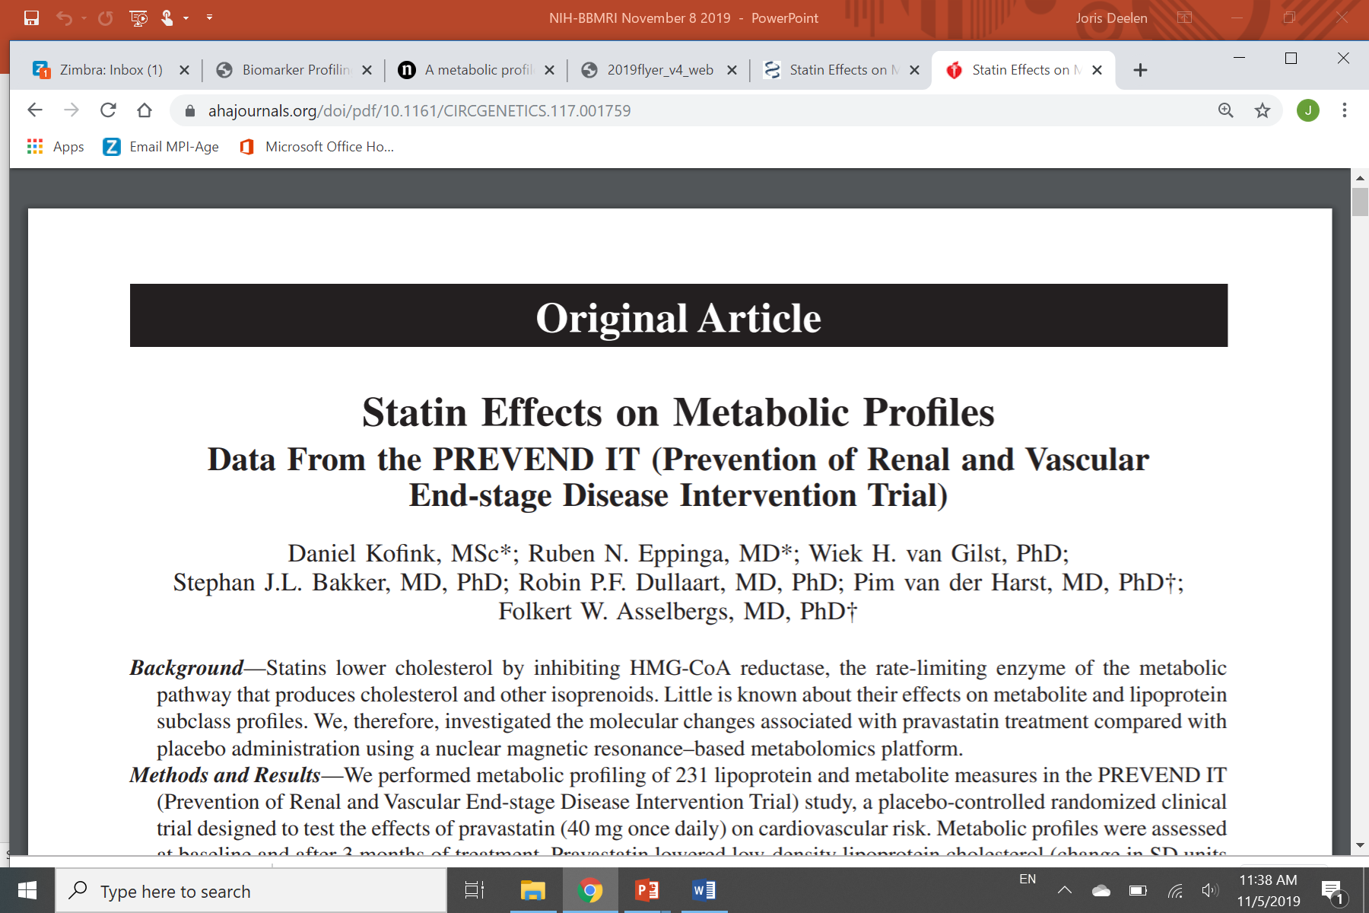
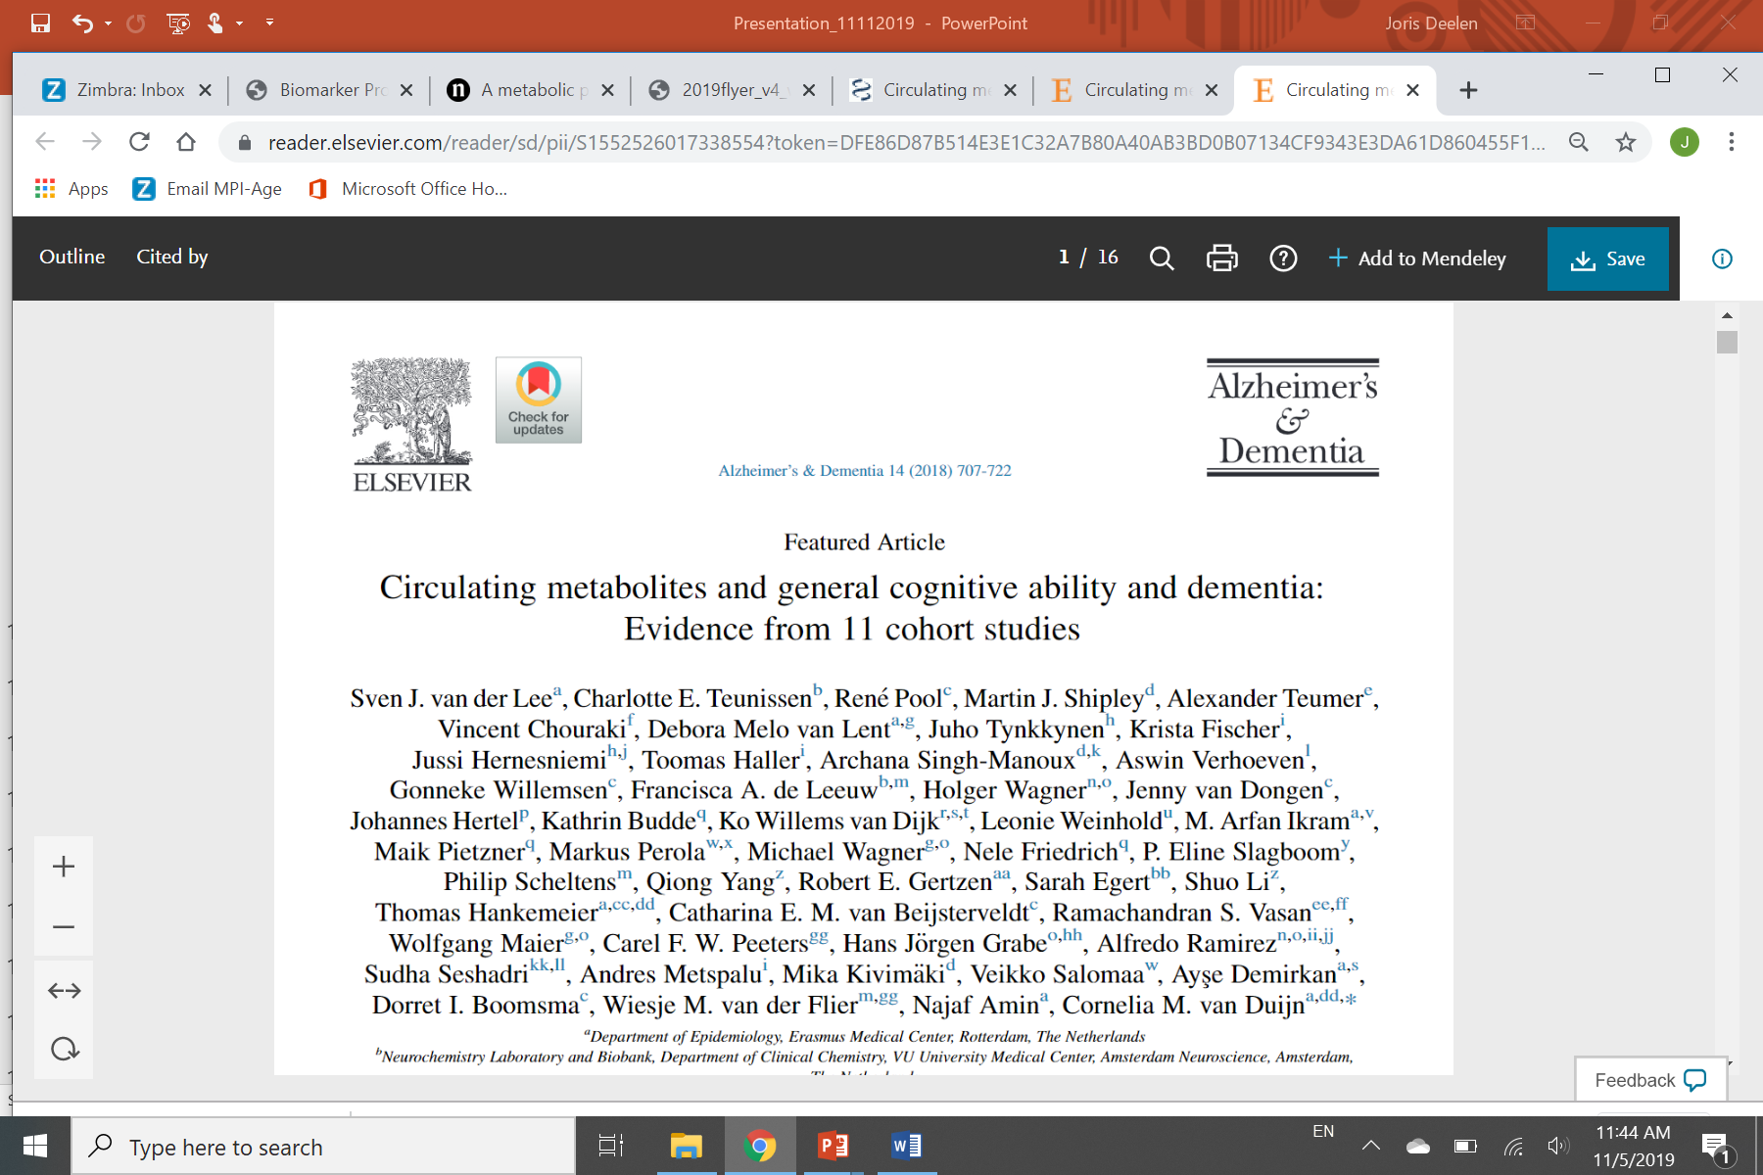
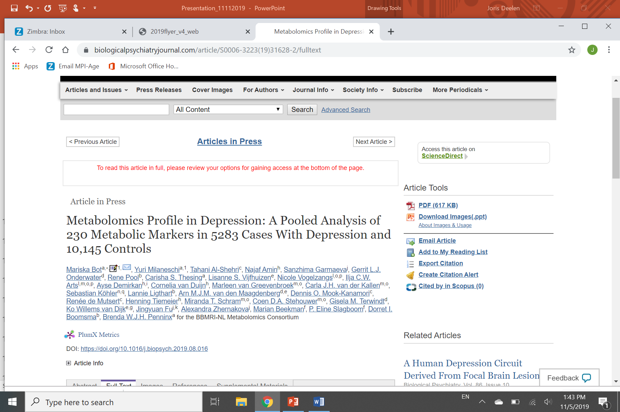
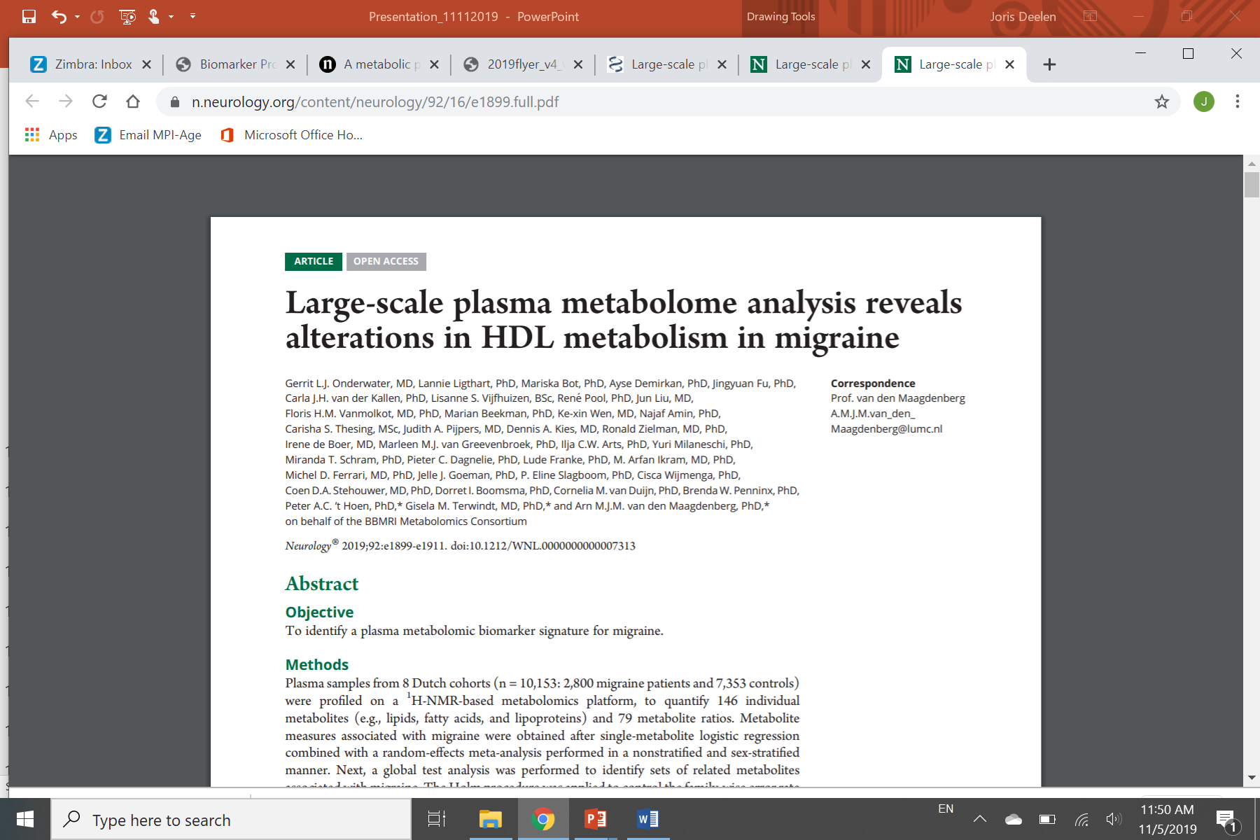
1H-NMR metabolome in 25.000 Dutch Caucasians 22 Prospective Patient and Cohort studies for 7 Diseases BBMRI-metabolomics consortium www.bbmri.nl/omics-metabolomics
Type 2 Diabetes
Cardiovascular Disease
Osteoarthritis
Metabolome
N=25,000
Dementia
Ageing Mortality
Depression
Migraine

Slide 16

Steps to prove the molecular markers make a novel predictor
Generate a predictor : factor identification and model development :
Exploration of associations between metabolites and diverse endpoints.
Cross sectional → Prospective/longitudinal follow-up studies
3. Univariate (single metabolites) , multivariate
4. Replication in independent studies
5. Meta-analysis in multiple studies, create predictors (for example of mortality risk) and compare to existing predictors

Slide 17
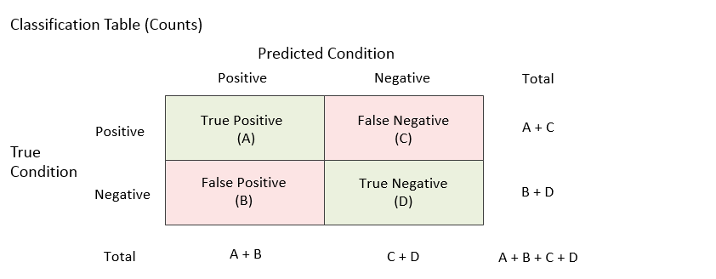
Prediction of disease risk Using omics variables; how to understand the literature

Slide 18
Receiver Operator Characteristic (ROC) curves to compare novel and traditional predictors (example 10 y CVD risk)
Blue : 50%-50%
→ AUC=0.5
Red : model with Age , Diabetes, Smoking
→ AUC=0.67
Green: model with Age, Diabetes, Smoking HDLcholesterol and systolic blood pressure
→ AUC=0.75
True positive rate
True negative rate

Slide 19
MORTALITY: 1H NMR based analysis 44.000 subjects and 5.500 deaths
Study | N | Males (%) | Deaths
AlphaOmega | 568 | 428 (75.4%) | 157
ALSPAC | 4,351 | 0 (0%) | 17
EGCUT | 10,988 | 4,106 (37.4%) | 912
ERF | 680 | 307 (45.1%) | 107
FINRISK97 | 7,603 | 3,778 (49.7%) | 1,213
FINRISK07 | 4,816 | 2,256 (46.8%) | 190
KORA | 1,790 | 871 (48.7%) | 123
LLS nonagenarians | 843 | 326 (38.7%) | 823
LLS offspring + partners | 2,241 | 999 (44.6%) | 191
PROSPER | 5,329 | 2,583 (48.5%) | 467
Rotterdam Study | 2,963 | 1,241 (41.9%) | 1,254
TwinsUK | 1,996 | 0 (0%) | 58
 | 44,168 |  | 5,512

Slide 20
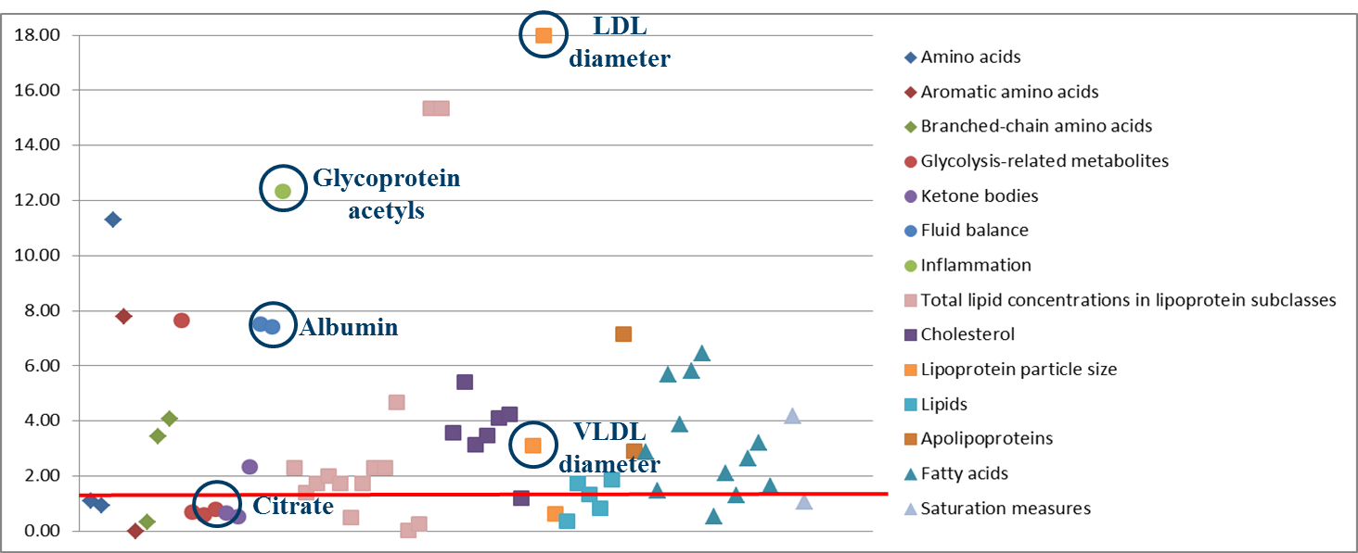
1H NMR-Based Metabolites associating to Mortality

Slide 21
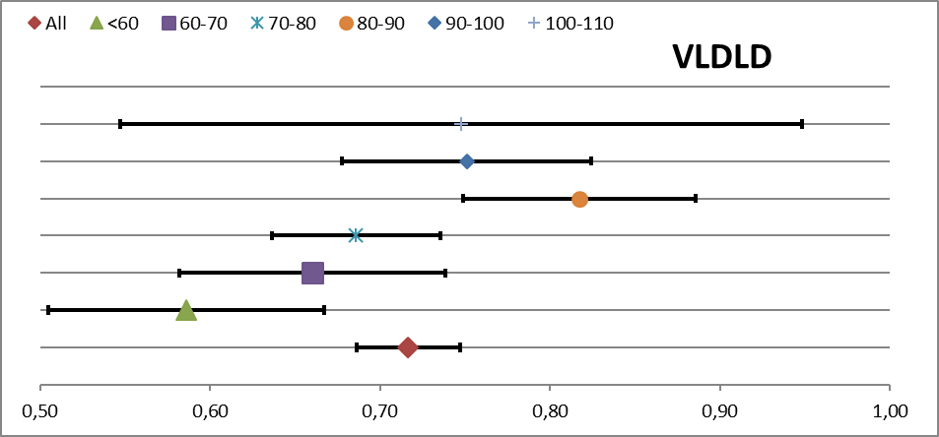
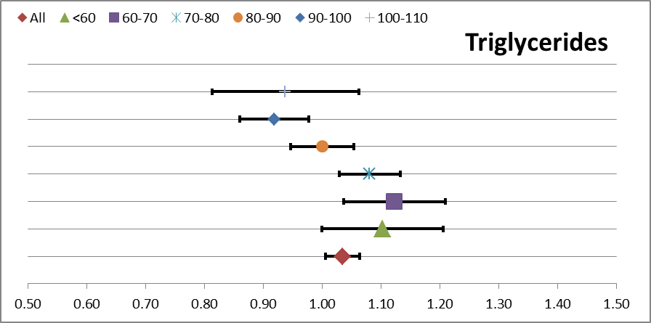
Mortality 1H NMR : Analysis of age strata: two examples
Association of metabolites with mortality depends on age.

Slide 22
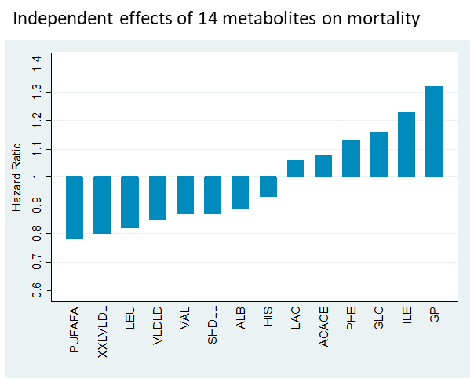
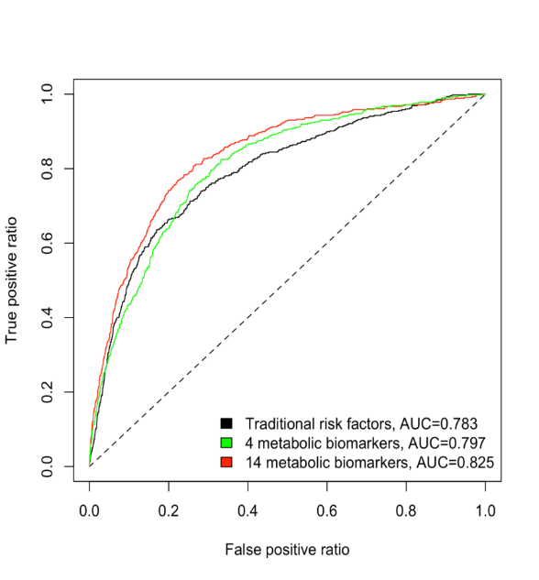
14 metabolites independently associate with mortality A score of 14 metabolites predicts mortality (cancer/inf disease/cvd) better than conventional variables. Deelen et al., Nat Comm 2019
5 years mortality
Lipoprotein particle sizes (VLDL, HDL),
branched chain/aromatic aminoacids,
Keton bodies, inflammation, glucose/lactate,
PUFA, fluid balance

Slide 23


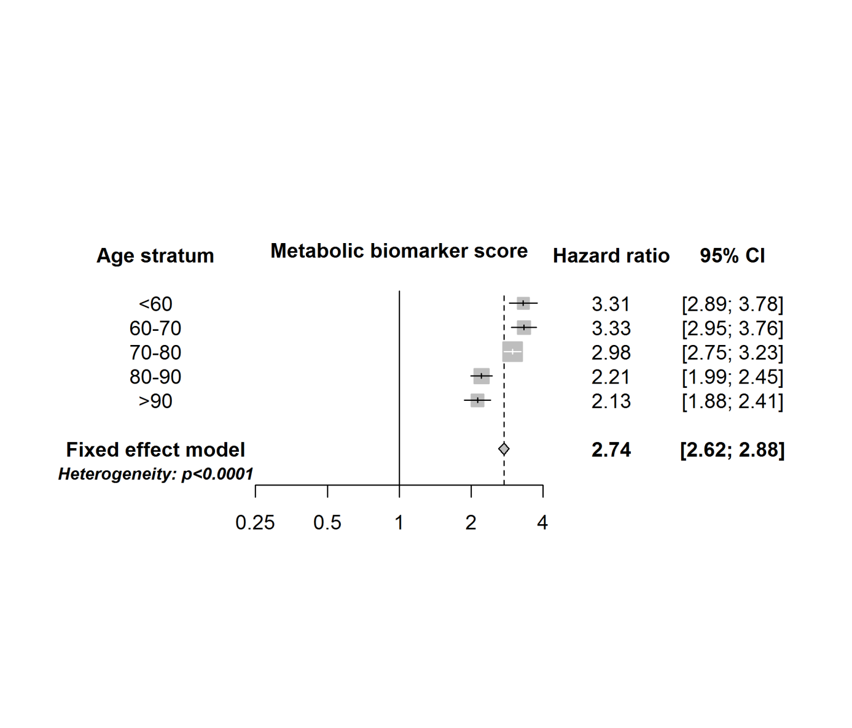
The effect of the biomarkers on all-cause mortality is consistent across studies and age strata

Slide 24
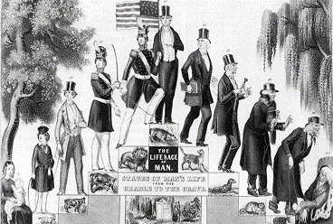
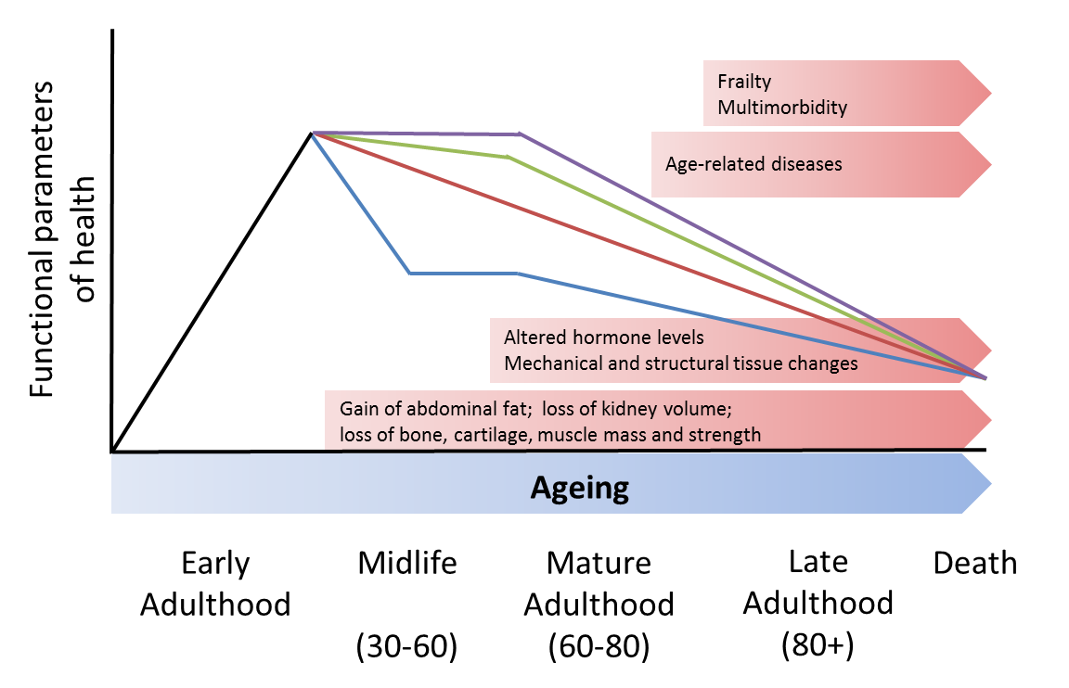
Ageing is a personal process
Capacity building, maintenance, and decline
Capacity maintenance
Homeostatic/physiological decline
Capacity building
Facing up to the global challenges of ageing
Nature 561, pages45–56 (2018)

Slide 25
Biological Age (BA) versus Chronological Age (CA)
Alex Comfort 1969 Lancet. 1969;2:1411–1414.
Test-battery to measure ageing-rate in man.
Clinical variables as read out of multiple organ systems
(skeleton, body composition, liver , kidney, lung , heart; immune and metabolic health)
height , weight , BMI, waist circumference , systolic /diastolic blood pressure ,
fasting blood sugar, total cholesterol, (HDL-C and LDL-C) , triglyceride, hemoglobin (Hgb),
serum creatinine, glomerular filtration rate (eGFR),
aspartate amin¬otransferase (AST), alanine aminotransferase (ALT),
gamma glutamyl transpeptidase (r-GTP), urine protein,
forced expiratory volume at 1 second (FEV1),
C-reactive protein (CRP), and cytomegalovirus (CMV) optical density.
Now: also molecular variables. Telomere repeat length, DNA methylation etc.

Slide 26
Biological Age Predictors WHY
- to measure an individual’s overall health status
- predict the risk of death , surrogate endpoint
- predict the risk of age-related disease incidence
- evaluate the effect of a health care program
- evaluate the effect of lifestyle/management interventions
- to use as phenotype in etiological studies
- cross over to animal studies

Slide 27
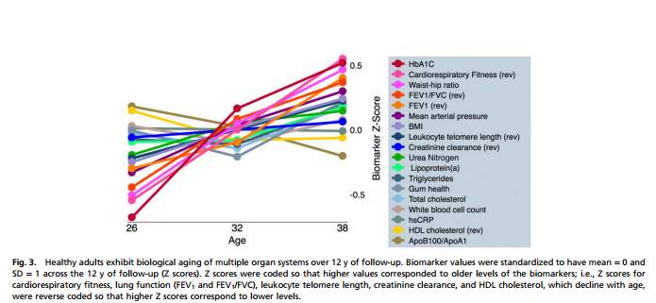
Biological age – markers Clinical variables (clocks) tracking age
Output multiple organ systems. Belsky et al., PNAS 2015 .
1000 subjects 38 year old. NHANES Biological Age index: 28-61 years
Longitudinal measures at 26, 32 and 38 years: personal rates of physiological decline

Slide 28
Physical capability

Slide 29
Cognition

Slide 30
Multivariate combinations
of biomarkers
Frailty: an accumulation of deficits
Mitnitski AB, Mogilner AJ, Rockwood K.
Sci World J. 2001
Now: electronic health records
for hospital based frailty scores
NHANES Biological Age
Levine and Crimmins
Am J Hum Biol. 2014
Age >30
Metabolomics mortality
Score (Deelen Nat Comm 2019)
Pace of Aging Belsky et al., PNAS 2015
Age 26-38, multiple organ systems
Gum health; also telomeres

Slide 31
Remark
a characteristic that is objectively measured and evaluated as an indicator of normal biological processes, pathogenic processes, or pharmacologic responses to a therapeutic intervention
Others have tried to make predictors of biological age on the basis of the relation of molecular patterns and chronological age (mostly in cross sectional studies). This was done for DNA methylation, transcriptome and for metabolome.

Slide 32
Biological Age Prediction based on chronological age
Molecular data on cross-sectional blood levels
Horvath et al., DNAmAge 2013 ; Deelen et al., 2013
‘older’ level/profile;
faster ageing rate
Predicted age – chronological age=
Age
Level
‘younger’level/profile;
slower ageing rate
0
10
20
30
40
50
60
70
80
90
100
110
Chronological age

Slide 33
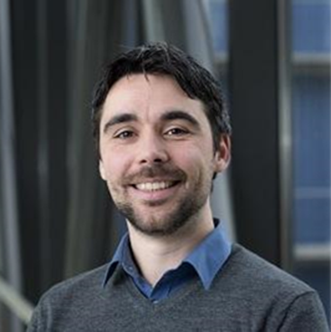
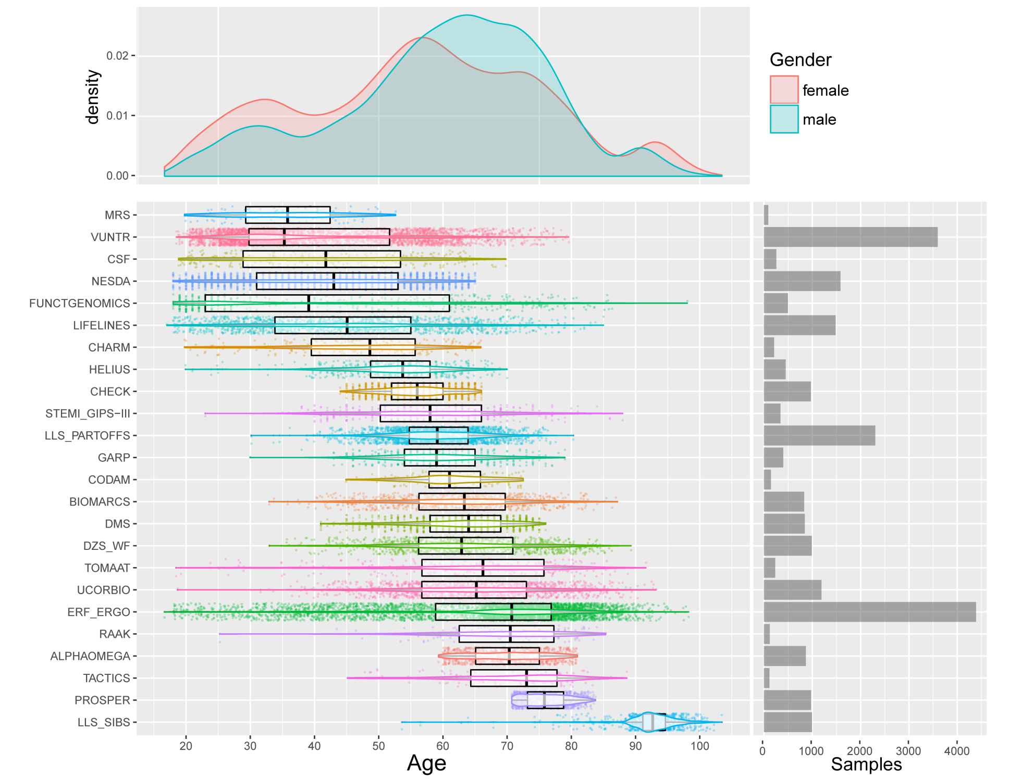
BBMRI Study Population after Quality Control BBMRI: 25 453 samples from 26 biobanks
E.B. van den Akker et al., Circ Genom Precis Med. 2020; 13
Erik van den Akker

Slide 34
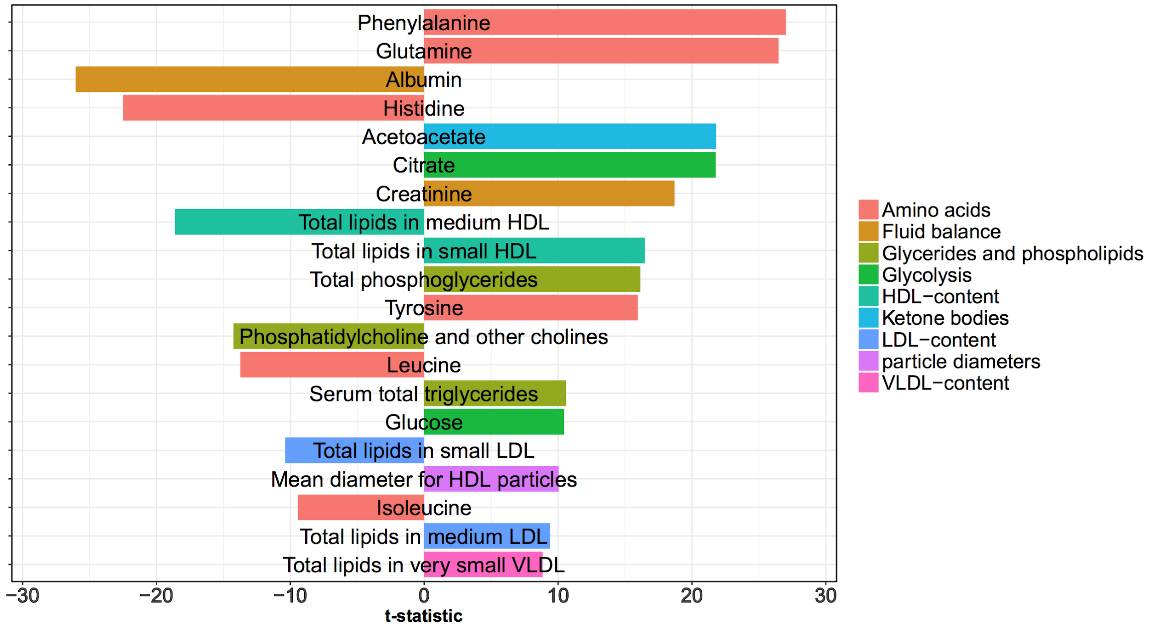
Training the age-predictor Contributing metabolites
Note: metabolites are scaled and centered before modelling!

Slide 35
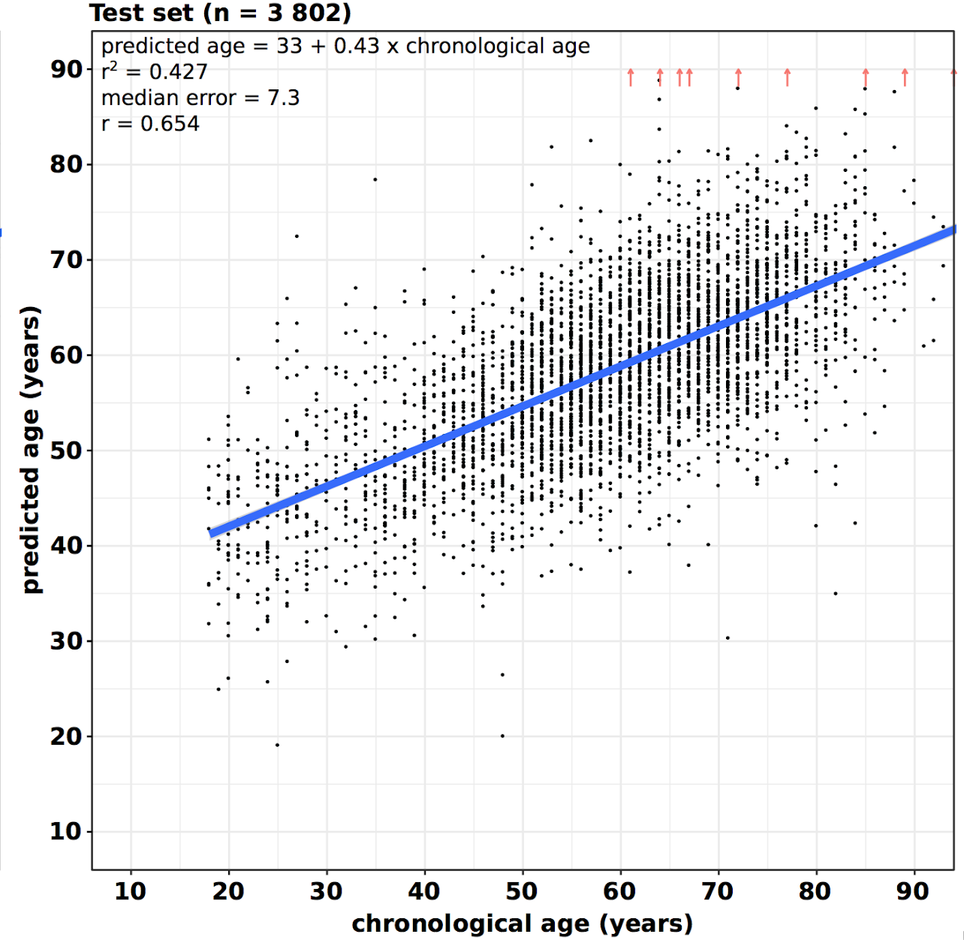
Construction of the metaboAge Score The age-independent part of the age-predictor
Δage = predicted age - chronological age
Regress out chronological age:
metaboAge = resid(lm(Δage ~ chron. age))

Slide 36
∆metaboAge associates to incident mortality LLS : 811 90+ individuals; PROSER 6000 70+ individuals
van den Akker et al. Circ Genom Precis Med 2020
Mortality in PROSPER
Mortality in LLS : HR = 1.25 p = 2.4 x 10 -6
With every year older metaboAge:
2-4% increased mortality risk
Comparable to DNAmAge
Independent of BMI, smoking, diabetes and
hypertension and medication
Notes:
The depicted HR is based on a ∆metaboAge increase of 10 years.

Slide 37
Remark
a characteristic that is objectively measured and evaluated as an indicator of normal biological processes, pathogenic processes, or pharmacologic responses to a therapeutic intervention
You must prove that a predictor predicts a relevant outcome: if the predictor indicates biological age than it should associate with and predict onset of disease and mortality, for example.

Slide 38
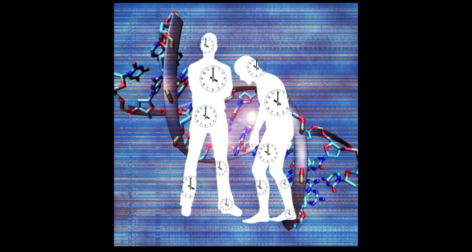
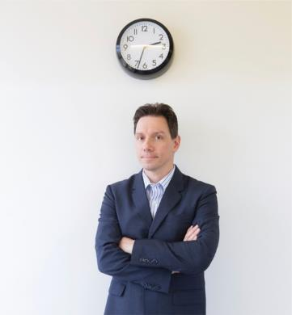
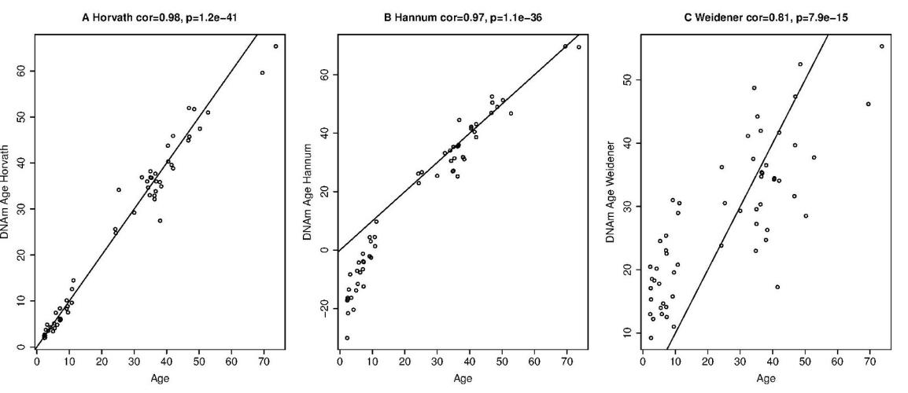
Regularities with chronological age. DNA methylation (Hannum, Horvath)
DNAmage predicts:
Mortality
Cancer risk
Obesity
Gestational age
Brain tissue ageing
HR 1.02-1.04 Effect size for mortality:

Slide 39
Remark
a characteristic that is objectively measured and evaluated as an indicator of normal biological processes, pathogenic processes, or pharmacologic responses to a therapeutic intervention
Two attempts are being made to make predictors from the metabolome.
Based on chronological age
Based on mortality

Slide 40
Molecular Epidemiology
Introduced by Kilbourne (1973), infectious diseases; Schulte and Perera (1993 Principles and Practices)
Integrates Epidemiology, Medical Sciences and Molecular Biology
Studies the influence on health of environmental and genetic risk factors measured by (holistic) molecular signatures
Contributes to
prediction/prognosis
monitoring exposure, response to interventions
etiological understanding (disease mechanisms)
Notes:
The Molecular Epidemiology field started first with the study of cancer and infectious diseases , the concept being initiated in 1973 and descibed in practice only in 1993. Summarise what the field is about.

Slide 41
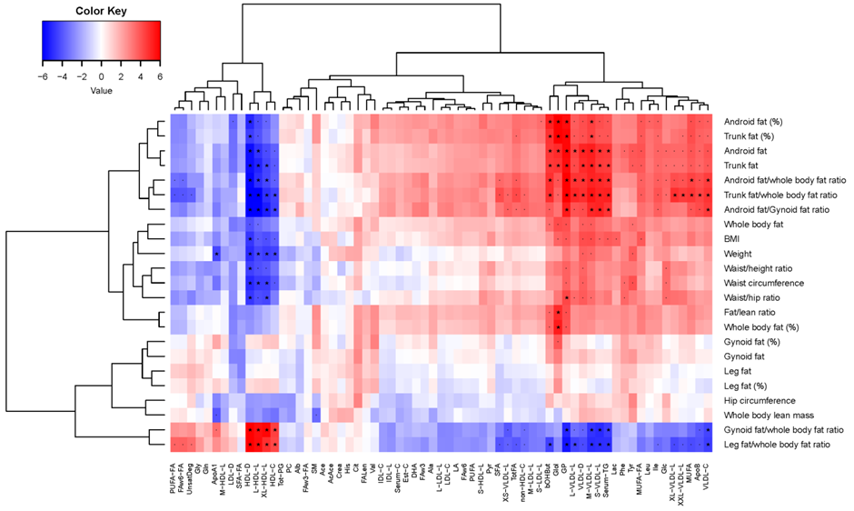
Which metaboliotes associate at baseline with DEXA scan variables of fat distribution. Heat map Which metabolites monitor response to intervention

Slide 42
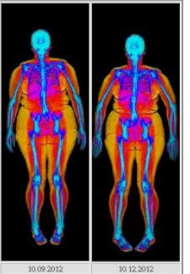
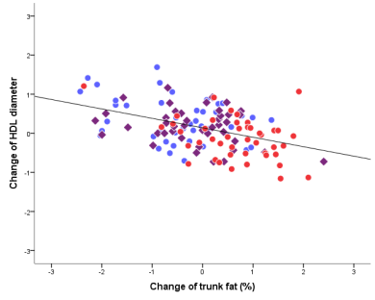
Example : indicate a change in body composition on a DEXA scan by metabolomics markers (HDL diameter)
Measure 1H NMR metabolome In intervention studies
Generate omics biomarkers for biological age prediction
And generate Health biomarkers indicating a response to a lifestyle intervention

Slide 43
Exercise: discussion of Marioni paper
Biomarkers of biological age:
DNA methylation
Telomeres

Slide 44
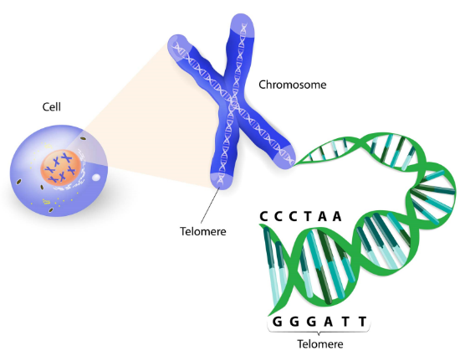
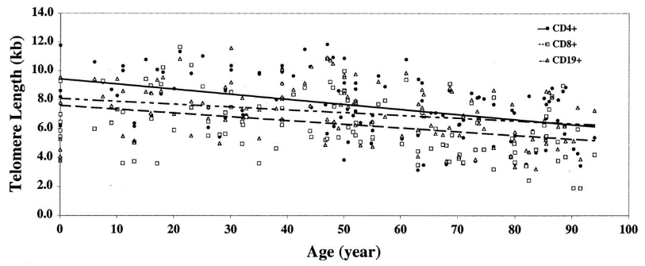
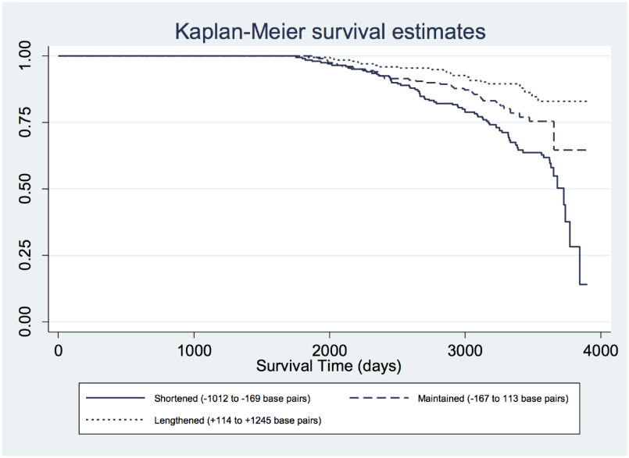
Telomere shortening, age and mortality prediction

Slide 45
Regularities with chronological age. DNA methylation (Hannum, Horvath)

Slide 46
Questions for the Discussion on Biological Age Predictors. Marioni paper
What is the main aim of the paper, main research question and subquestions.
Q1, 2 etc.
2. Why, do authors investigate this, what is the issue or the problem?
3. What new research strategy would solve the problem
4. What is the study design (which can be variable for answering the different questions). What is measured in which study population. Is ther anything remarkable about the study populations ? Usually Table 1
5. What answers were found to the questions
Q 1, 2 etc.
6. What are the main conclusions and the main discussion points the authors bring up.
7. What do you think of the paper ? Was it clear, was it presented in a logical way, what would you have done differently.

